Slide 1
WEB Technologies (CS-566)
LECTURE # 1 – Introduction

Slide 2
Reference Material
Reference Books
Web enabled Commercial Application Development Using…HTML, DHTML, JavaScript, Perl, CGI, Ivan Bayross, BPB Publications.
HTML5 & CSS3 Visual QuickStart Guide (7th Edition) by Elizabeth Castro, Bruce Hyslop.
Programming PHP Systems by Rasmus Lerdorf and Kevin Tatroe.
A lot of material is available online.
Presentations

Slide 3
World Wide Web

Slide 4
World Wide Web
Internet connects two or more autonomous (Independent) computers worldwide. It is network of computers.
The web is a tool used to retrieve information published on the internet
To navigate the web we use a browser i.e. Internet explorer, Mozilla, Firefox, Google Chrome etc.

Slide 5
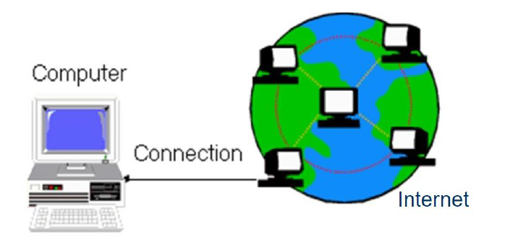
Cont…

Slide 6
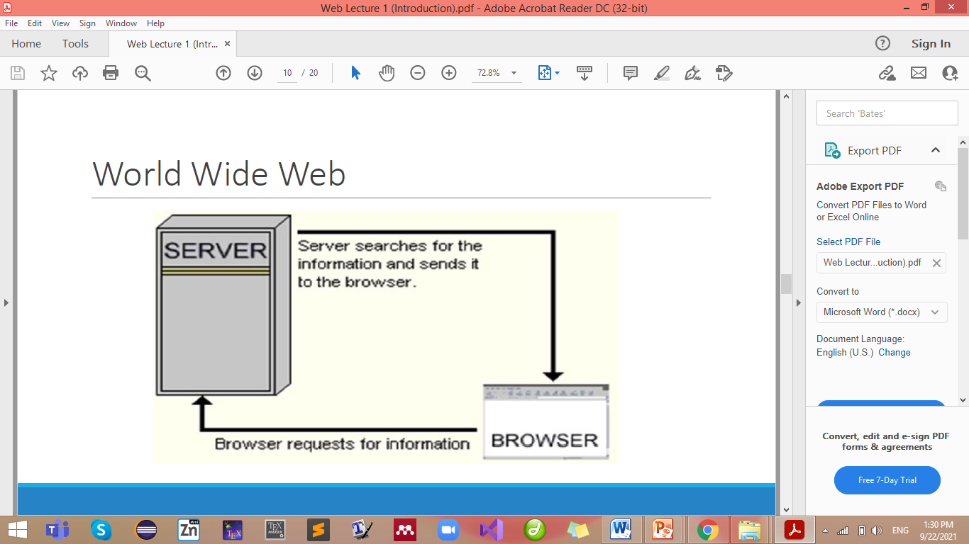
Cont…

Slide 7
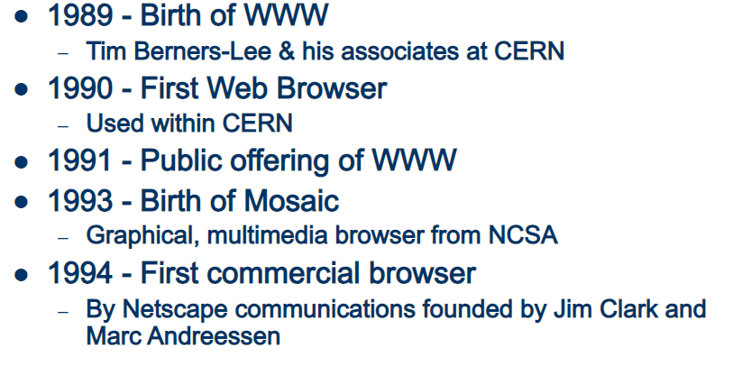
WWW History

Slide 8
Websites and Web Applications

Slide 9
Websites and Web Applications
Websites:
One-way informational feeds (most of the time), they do not allow viewers to interact or communicate back to the site. i.e. Blogs
Complex websites, like online stores and media portals, have dynamic content.
For example, Google, Amazon, and Netflix.
Web application:
is designed for interaction with the end user.
are websites with functionality and interactive elements.
Gmail, Facebook, YouTube, Twitter, etc. are all web apps that are dynamic, and built for user engagement.

Slide 10
Website Vs Web Application
 | Websites | Web Application
Implementation | Static Pages Navigation (Browsing)– many integrated hyperlinks with jumps to other pages | Dynamic Behavior Incorporates business logic May contain simple or complex navigation
Task and Complexity | Displays collected data and information on specific page. | Functions are quite higher and complex as compared to a website.
Authentication | Not mandatory for informational websites. | Need authentication, as they offer much broader scope of options
Example Apps | Blogs Educational Webpage | Amazon.com Wikipedia Facebook Gmail

Slide 11
Cont…
Amazon is website or web app??
Amazon is a web app.
However, when you start to categorize that way, you find nearly every site is a hybrid.
e.g. CNN.com includes sharing and commenting capabilities, all of which are web apps.

Slide 12
Summary
World Wide Web
Website Vs Web Application

Slide 13
Exercise Questions

Slide 14
Exercise Questions
Make a clear difference between Website and Web Application with the help of examples.

